Slide 1
Make Your Own Ray Tracing GPU with FPGA
COSCUP 2023
Owen Wu
fallingcat@gmail.com

Slide 2
Agenda
Self-Intro
Session Overview
How to Start
HDL
EDA
FPGA
Think Differently
Ray Tracing
HomebrewGPU projrect

Slide 3
Self-Intro

Slide 4
Self-Intro
Game developer
Game engine development
PC
Console
Mobile
GPU software engineer
Optimization from the perspective of hardware
AMD
Arm
https://tinyurl.com/owenwu

Slide 5
Session Overview

Slide 6
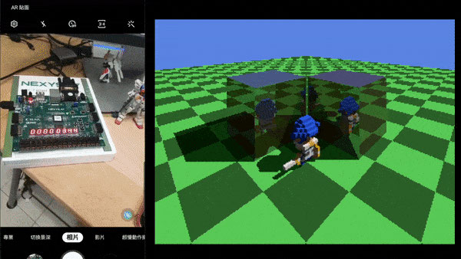
Session Overview
This session is for software engineer
This session is NOT for hardware engineer
Basic intro for the beginner
Making a chip is very easy and cheap nowaday
6 months from zero to a workable GPU
Turn you algorithm into hardware, think differently
Many open sourced projects on GitHub

Slide 7
How to Start

Slide 8
How to Start
HDL (Haardware Description Language)
Language
EDA (Electronic Design Automation)
Compiler
FPGA (Field Programmable Gate Array)
Hardware

Slide 9
HDL
Hardware Description Language

Slide 10
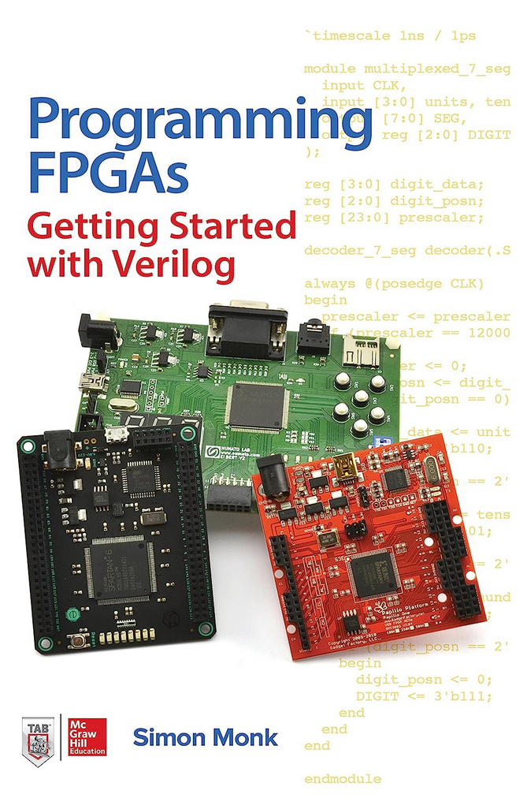
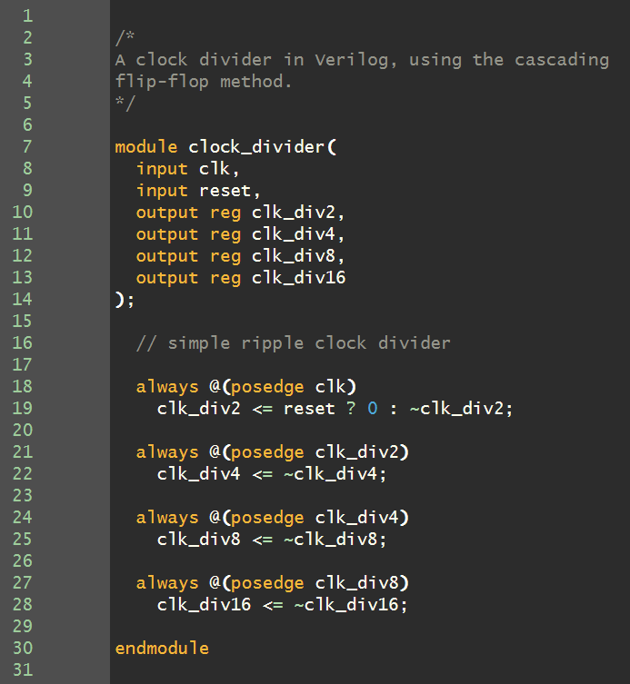
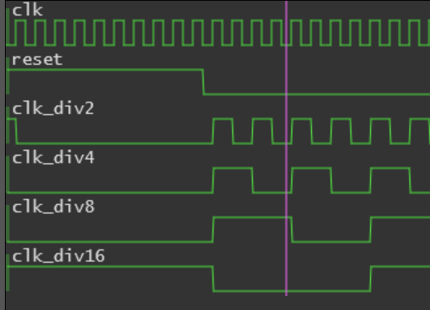
HDL
VHDL
Ada
Verilog
C
Connect modules to design a whole chip
Clock is the way to sync all modules
100M Hz - generate 100M signals in one second
You can think module as a function in C
Every module can only do very limited works
Works need to be finished in one clock
Books for begineer
Programming FPGAs: Getting Started with Verilog
Introduction to Verilog

Slide 11
EDA
Electronic Design Automation

Slide 12
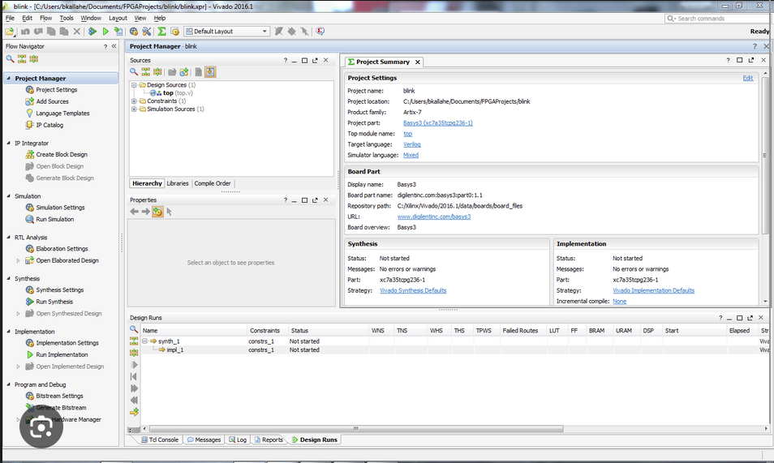
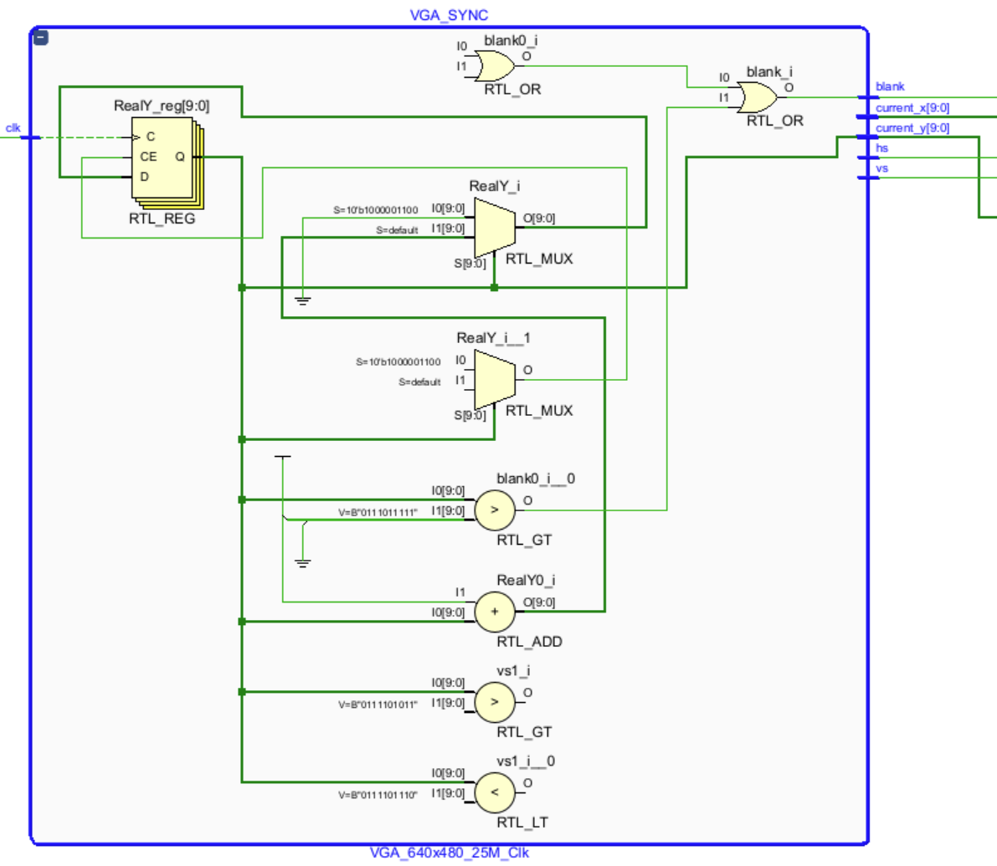
EDA
Convert HDL to bitstream file
Upload bitstream file to FPGA to execute
Many steps
IC Design
Synthesis
Verification
Physical Design
You can think EDA as a compiler
FPGA makers provide basic EDA for free
Xilinx Vivado
You can also try EDA online
https://8bitworkshop.com/v3.10.1/?platform=verilog&file=clock_divider.v

Slide 13
FPGA
Field Programmable Gate Array

Slide 14
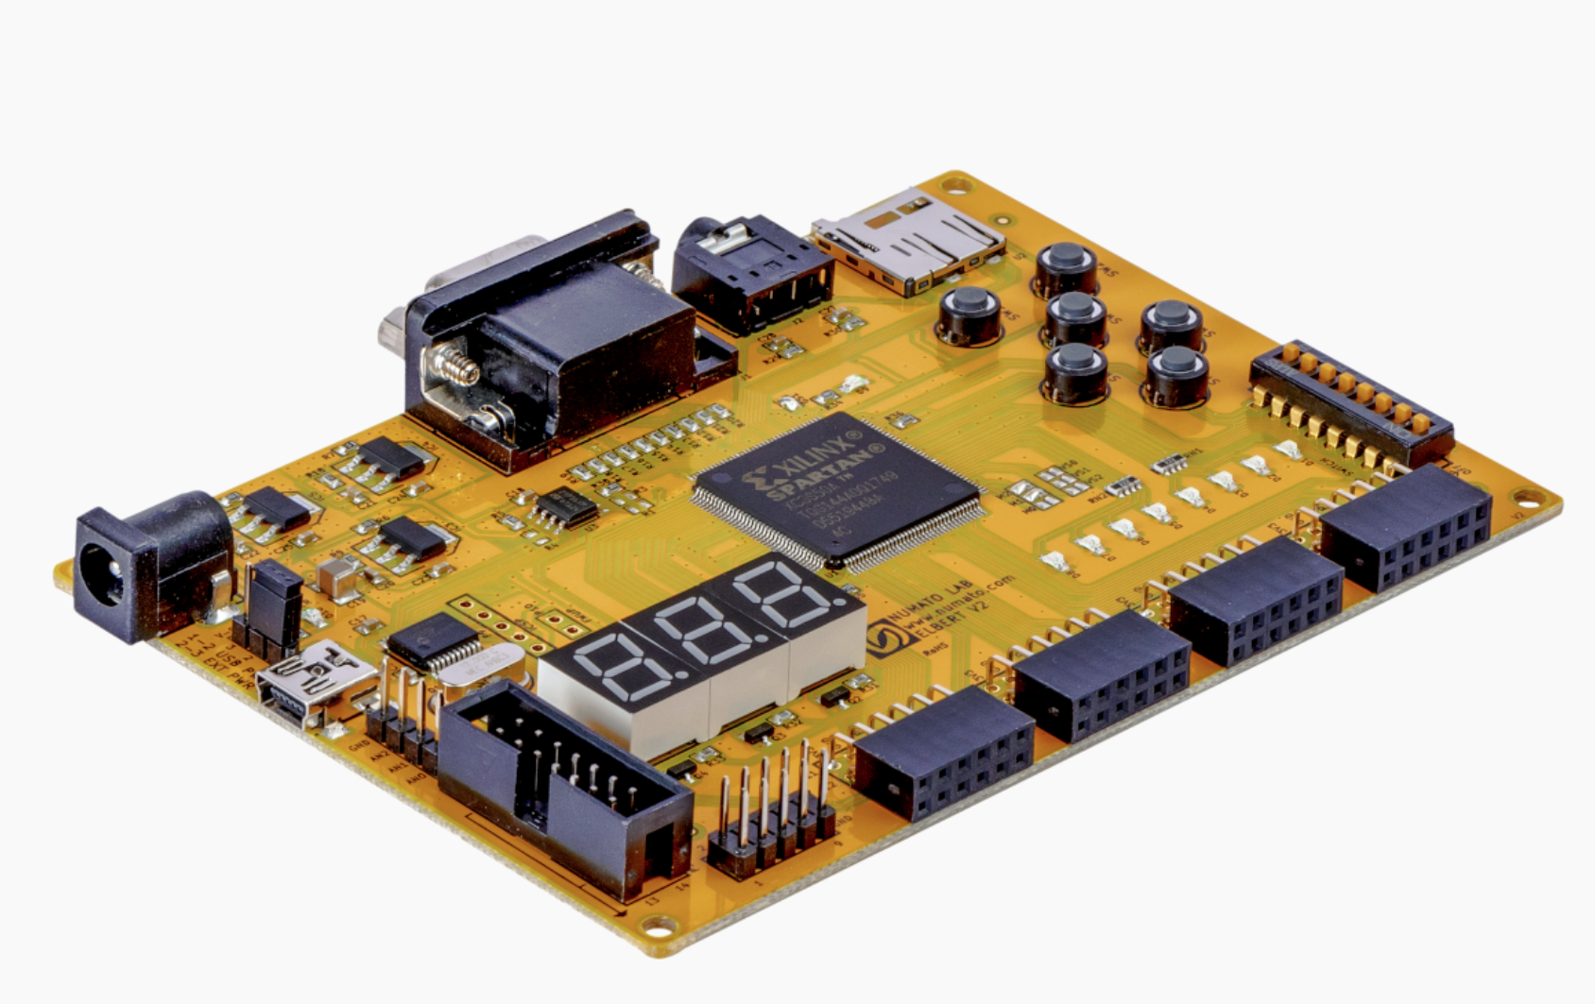
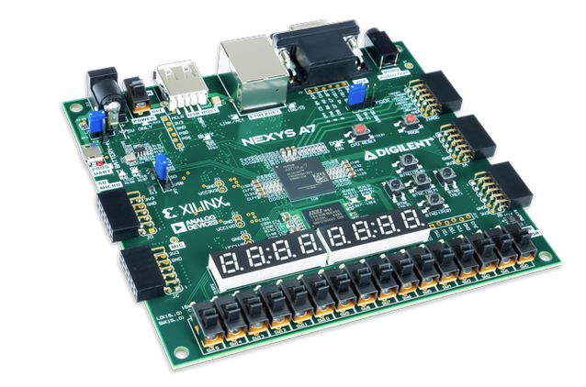
FPGA
Upload bitstream file to configure logic blocks
FPGA development board integrate many components
VGA/HDMI output
Memory
LED
7 segment disply
SD Card
SoC
FPGA has different number of logic cells
Which decides how complex the design can be
Elbert V2 for beginner
Nexys A7 for more complex design

Slide 15
Think Differently

Slide 16
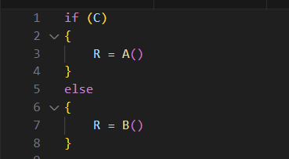
Parallel
Software is serial
Hardware is parallel
Every modules work simultaneously
Software optimizatios may not work with hardware
Don’t use software thinking when designing hardware
A()
MUX
R
B()
C

Slide 17
Latency v.s. Throughput
CPU performance depends on latency
Low latency means that the instruction can be completed quickly
Instruction has order dependency
GPU only care how long it takes to finish a frame
Pixel doesn’t have order dependency
Pixels can be executed simultaneously
If the latency of one pixel is 32 clock
The hardware executes 64 streams simultaneously
The throughput will be 2 pixel per clock

Slide 18
Pipeline
Hardware has many different modules
All modules need to work simultaneously to get the best performance
Use pipeline to split the tasks
Every module process different pixel at the same time
Surface | Shadow | Shading
pixel 1
pixel2 | pixel 1
pixel3 | pixel2 | pixel 1
pixel 4 | pixel 3 | pixel 2
clk 0
clk 5
clk 10
Surface (5 clk)
Shadow (5 clk)
Shading (5 clk)
clk 15
15 clk/pixel
5 clk/pixel

Slide 19
Ray Tracing

Slide 20
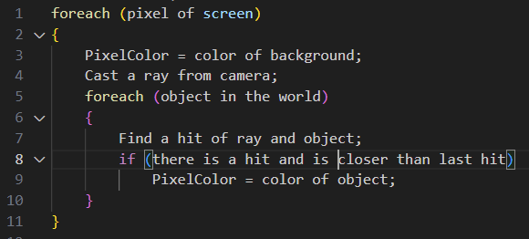
Ray Tracing
Ray tracing is easy to implement
Ray hit objects then reflect to camera
Invert the ray
Cast a ray from each pixel of the screen
Find a closest hit of ray and objects
Decide the color of the pixel
If there is a hit, the color of hit object
If there is no hit, the color of background
Ray Tracing in One Weekend at GitHub

Slide 21
Ray Tracing - Reflection
For the hit on a object
If the object is reflective
Cast a reflection ray from hit point
Find the closet hit of the reflection ray
Recursively cast reflection rays
Blend the colosr of reflected objects into final shading

Slide 22
Ray Tracing - Shadow
For the hit on a object
Cast a new ray from hit point toward light
Is there is any hit of the new ray
If yes, the pixel is in shadow
Otherwise the pixel is not in shadow

Slide 23
BVH(Bounding Volume Hierarchy)
Accelerate the hit detection between ray and primitives
Quickly exclude the nodes which don’t have intersection
Use AABB(Axis-aligned Bounding Box) to split the space
Traverse the AABB until reach the leaf
Detect the hits between ray and primitive in leaf
AABB
AABB
AABB
AABB
AABB
Left Node
Right Node

Slide 24
HomebrewGPU Project

Slide 25
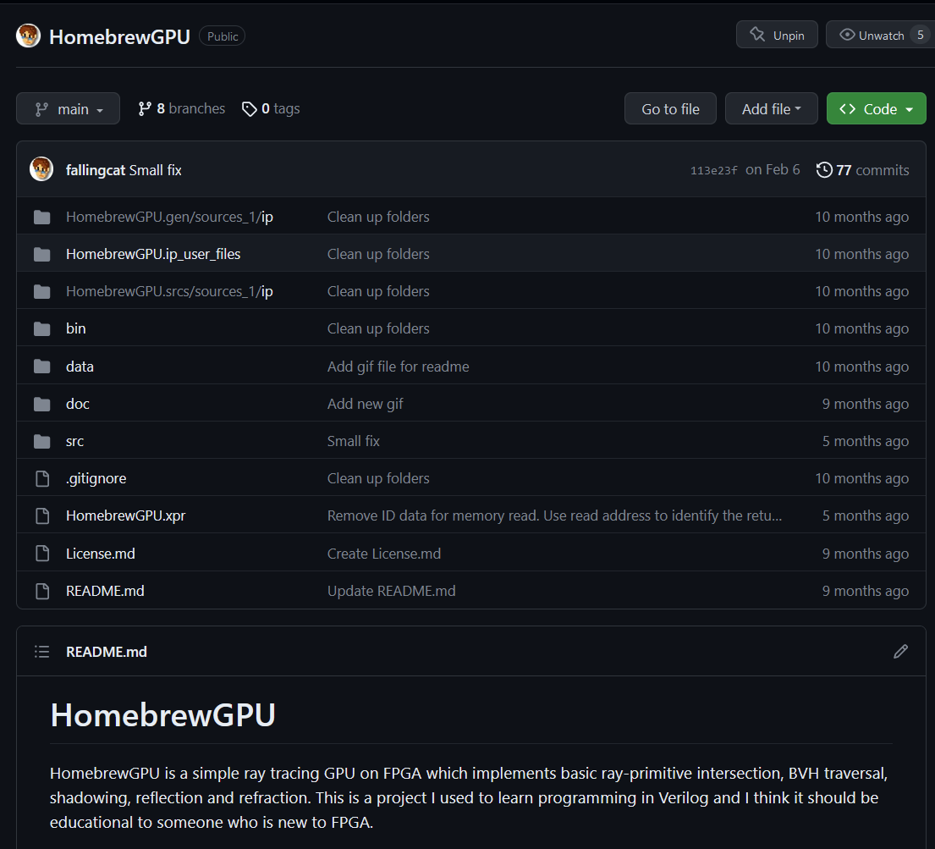
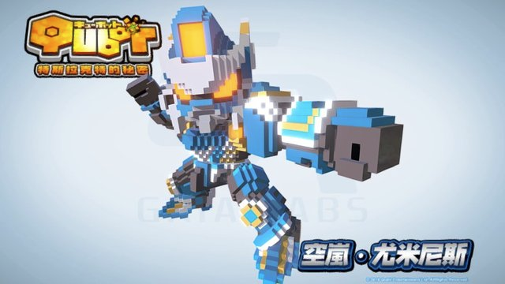
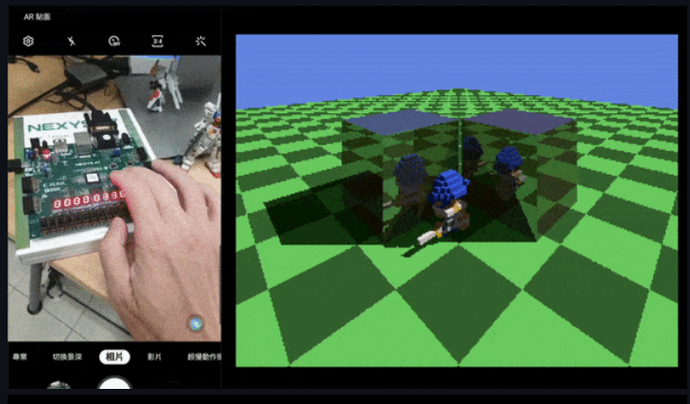
HomebrewGPU project
Open sourced project
https://github.com/fallingcat/HomebrewGPU
Implement a basic ray tracing GPU
Voxel based rendering
BVH acceleration
Shading/Reflection/Refraction/Shadow
6 months from zero to complete

Slide 26
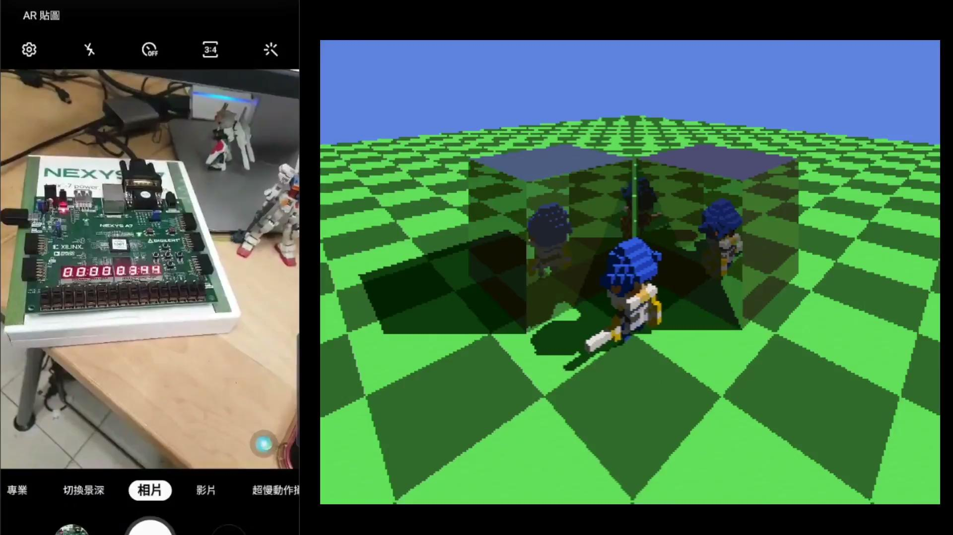
HomebrewGPU project

Slide 27
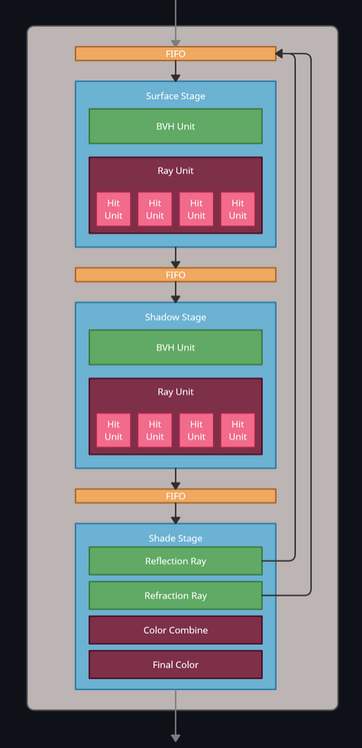
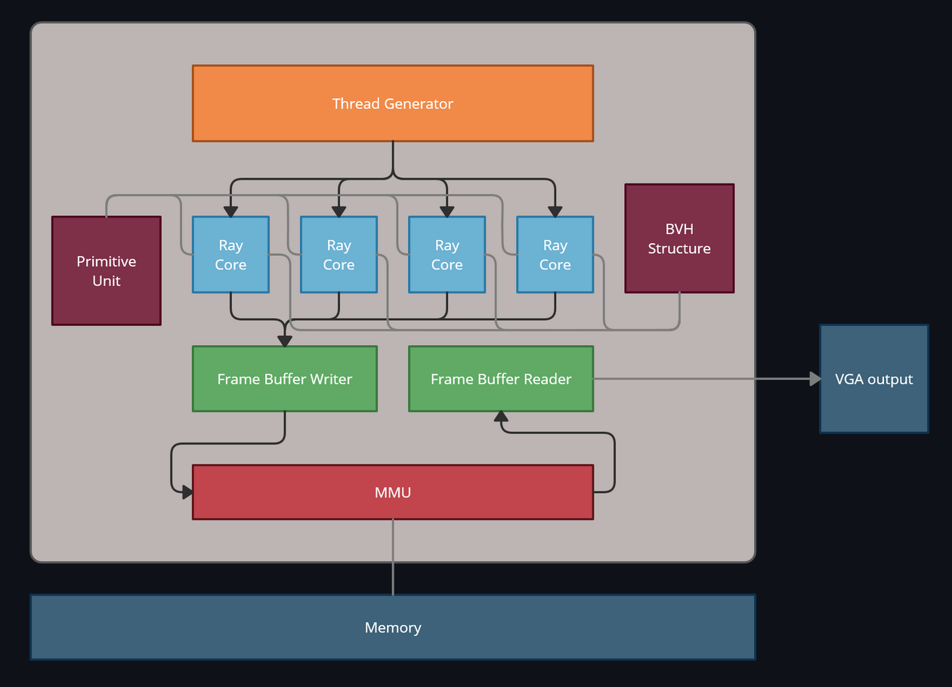
Architecture

Slide 28
Architecture
Thread Generator
Generate one thread per clock for each ray core
Each thread presents one pixel
The thread will go through ray core and output the final color
BVH Structure
BVH structure stores the BVH tree structure data
Accepts the node or leaf query from ray core
Output the node or leaf data to ray core
Primitive Unit
Primitive Unit stores the raw data of all primitives
Accepts the query from ray core and output primitive data
Ray Core
Ray core process one thread to output the final color
Accepts the thread from thread generator or reflection/refraction ray
Frame Buffer Writer
Cache the output of ray cores and write the pixel to frame buffer
Some threads with reflection/refraction take longer to get the final color
Wait util all threads in one cache set are finished then write the data to the frame buffer

Slide 29
Architecture
Surface stage
Process the ray from camera and find the closest hit of the ray
Pass the hit information to next stage
Shadow stage
Cast a ray from closest hit position to light source
It will pass the shadow information to next stage
Shade stage
Use the closest hit information to decide if it's the final color or reflection/refraction will occur
Cast a reflection/refraction ray and pass the data back to surface stage
Recursively feed back to surface stage

Slide 30
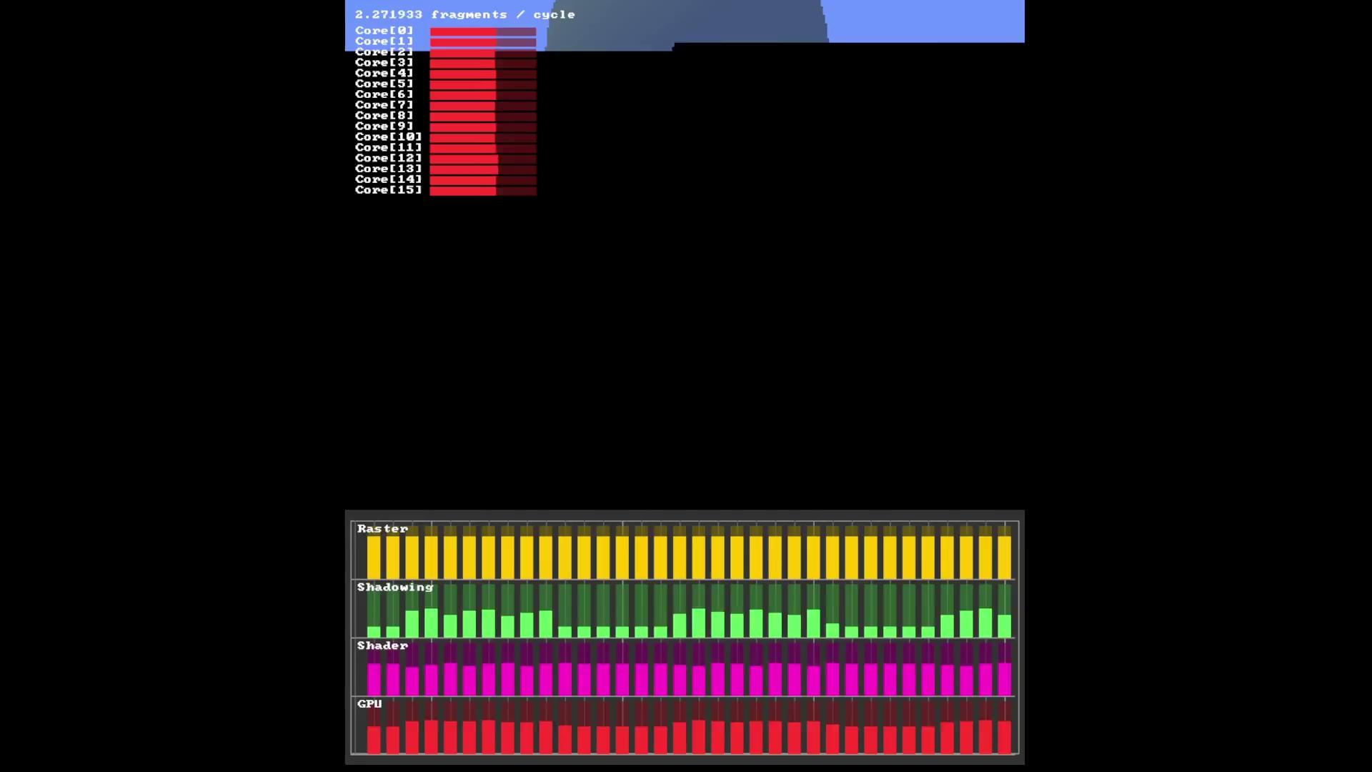
Design Verification

Slide 31
Q & A
Owen (fallingcat@gmail.com)
https://github.com/fallingcat/HomebrewGPU

Slide 32
Thanks!

